Slide 1
Cost and cost concepts.
Nathani. Smit. R.
Engineering Economics and Management
IT-1-C
ID NO. 16BEITG072 ENROLL NO. 160410116065

Slide 2
A cost is the value of money that has been used up to produce something.

Slide 3
Definition of cost
The expenses faced by the business in the process of supplying goods and services to consumer
Cost is Defined as the monitory expenditure which is used to produce factor of production to produce good and services

Slide 4
Types of costs
Opportunity cost and Sunk cost
Direct and indirect cost
Explicit and implicit cost
Historical and replacement cost
Fixed cost and variable cost
Total,average,and marginal cost
Short Run & Long Run Cost.

Slide 5
Opportunity Cost and Sunk Cost
Opportunity cost is the cost of a good or service as measured by the alternative uses that are foregone by producing the good or service.
If 15 bicycles could be produced with the materials used to produce an automobile, the opportunity cost of the automobile is 15 bicycles.
Sunk cost : Cost’s incurred in the past that cannot be changer or recovered later.
You bought an automobile that cost $12,000 two years ago. The $12,000 cost is sunk because whether you drive it, park it, trade it, sell it, you can’t charge the $12,000 cost.

Slide 6
Opportunity cost
For example, Mr. Ram is currently working with a firm and earning Rs. 5 lakhs per year. He decides to quit his job and start his own small business. Although, the accounting cost of Mr. Ram’s labour to his own business is 0, the opportunity cost is Rs. 5 lakhs per year. Therefore, the opportunity cost is the earnings he foregoes by working for his own firm.
Some times these opportunity costs are called as alternative costs.

Slide 7
Direct and Indirect cost
Direct Cost:
Direct costs are those cost that have directly accountable to specific cost object such as a process or product
Ex:wages paid ,salary paid labor, material…etc
Indirect cost:
Indirect cost are those costs which are not directly accountable to specific cost object or not directly related to production
Ex: insurance, mentainence ,telecom, ….etc

Slide 8
Explicit and implicit cost
Explicit cost refers to the money expended to buy or hire resources from outside the organization for the process of production
Implicit cost refers to the cost of use of the self owned resources of organization that are used in production

Slide 9
CASE STUDY:EXPLICIT Cost, Historical Cost & Replacement Cost
Explicit Cost
For example, a firm pays Rs. 100 per day to a worker and engages 15 workers for 10 days, the explicit cost will be Rs. 15,000 incurred by the firm. Other types of explicit costs include purchase of raw materials, renting a building, amount spent on advertising etc.
Historical & Replacement Cost.
suppose a machine was acquired for Rs. 50,000 in the year 1995 and the same machine can be acquired for Rs. 1,20,000 in the year 2001. Here Rs. 50,000 is the historical or original cost of the machine and Rs. 1,20,000 is its replacement cost. The difference of Rs.70,000 between the two costs has resulted because of the price change of the machine during the period. In the conventional financial accounts the value of assets is shown at their historical costs

Slide 10
Historical and replacement cost
Historical cost refers to the original (actual) cost incurred at the time the asset was acquired(Bought)
The replacement cost is the price that an entity would pay to replace an existing assets at current market price that may not be market value of that asset.

Slide 11
SHORT-RUN AND LONG-RUN COSTS
Short Run Cost:- The short run is defined as a period in which the supply of at least one element of the inputs cannot be changed. To illustrate, certain inputs like machinery, buildings, etc., cannot be changed by the firm whenever it so desires. It takes time to replace, add or dismantle them.
Long Run Cost:- Long run, on the other hand, is defined as a period in which all inputs are changed with changes in output. In other words, it is that time-span in which all adjustments and changes are possible to realize.

Slide 12
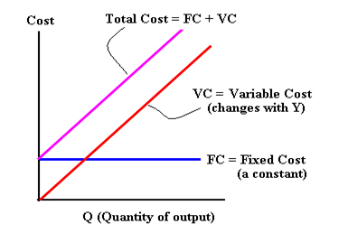
Fixed and variable cost
Fixed cost is the cost that remains unchanged irrespective of the output level or sales revenue such as intrest,rent,salaries etc
Variable cost are thoese costs that vary depending on a company’s production volume; they raise as production increases and fall as production decreases

Slide 13
Real cost
Real cost of a production refers to the physical quantities of various factors used in producing commodity
Ex: Real cost of a table composes of a carpenter’s labor to cubic feet of a wood ,a dozen of nails, half a bottle of varnish…..etc
“ Real cost thus signifies the aggregate of real productive resources absorbed in the production”

Slide 14
Prime cost
The direct cost of commodity in terms of the materials and labor involved in its production excluding fixed cost
By calculating prime cost the firm can decide how much should be their selling price to earn profit

Slide 15
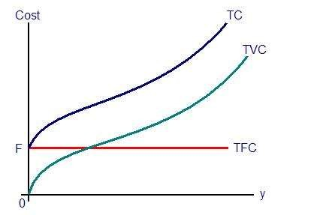
Total cost
Total cost : it is the cost refers to the total expenses incurred in reaching a particular level of output
TC = TVC + TFC

Slide 16
Marginal cost
The marginal cost is also per unit cost of production. It is the addition made to the total cost by producing one more unit of output
MCn = TCn-TCn-1
Q
i.e the marginal cost of the unit of output is the total cost of producing n units minus the total cost of producing
n-1 (i.e …one less in the total) units of output

Slide 17
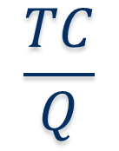
Average cost
Average cost is the total cost divided by total units of output Thus,
AC =
Where Q is the quantity produced
$$\frac{TC}{Q}$$

Slide 18
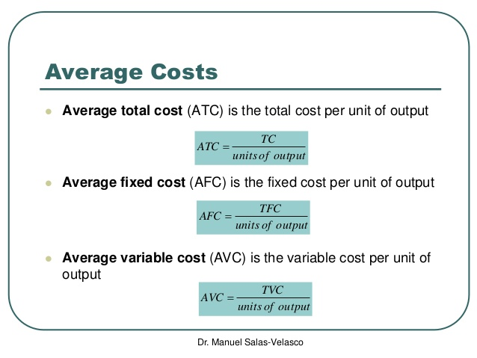
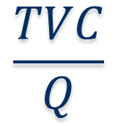
$$\frac{TVC}{Q}$$

Slide 19
CASE STUDY : TC & MC &AC
Total cost (TC) of a firm is the sum-total of all the explicit and implicit expenditures incurred for producing a given level of output. It represents the money value of the total resources required for production of goods and services. For example, a shoe-maker’s total cost will include the amount she/ he spends on leather, thread, rent for his/her workshop, interest on borrowed capital, wages and salaries of employees, etc., and the amount she/he charges for his/her services and funds invested in the business.
Average cost (AC) is the cost per unit of output. That is, average cost equals the total cost divided by the number of units produced (N). If TC = Rs. 500 and N = 50 then AC = Rs. 10.
Marginal cost (MC) is the extra cost of producing one additional unit. At a given level of output, one examines the additional costs being incurred in producing one extra unit and this yields the marginal cost. For example, if TC of producing 100 units is Rs. 10,000 and the TC of producing 101 units is Rs. 10,050, then MC at N = 101 equals Rs.50

Slide 20
THANK YOU

